Slide 1
UPPER SOUTHAMPTON TOWNSHIP
PUBLIC MEETING PRESENTATION
STORMWATER
JUNE 16, 2026
Presented by:
Tri-State Engineers and Land Surveyors, Inc

Slide 2
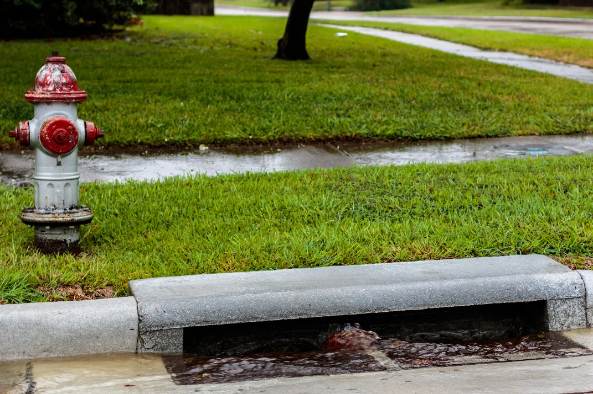
What is Stormwater
Stormwater is water from rain and snow that can pick up pollutants as it flows over surfaces such as roads, sidewalks, buildings, and landscapes.
Notes:
Stormwater that is not absorbed into the ground picks up pollutants, such as dirt and loose sediment, gasoline and oil, and other chemicals and debris, as it flows into storm drains and down to [name of local waterway(s)], bringing pollution with it.
Managing stormwater appropriately is vital to the health of waterways, our community, and our quality of life.
NOTE: REPLACE THE PHOTO WITH ONE OF YOUR COMMUNITY STORM DRAINS

Slide 3
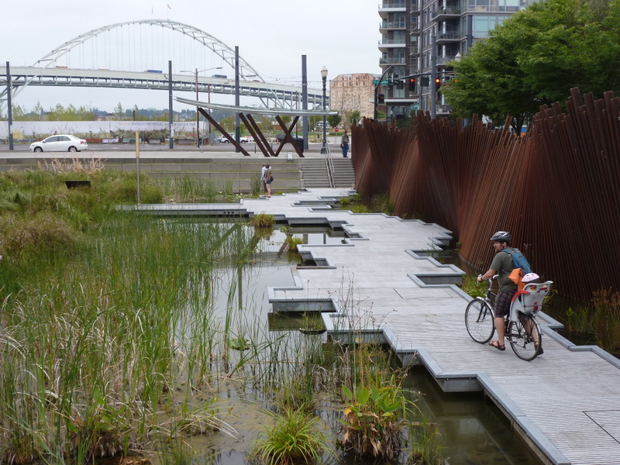
Why Care About Stormwater
MS4
Municipal Separate Storm Sewer System
MS4 communities such as ours are required to implement a program that continually improves stormwater management.
Notes:
[CITY NAME] has what’s called an “MS4.” A Municipal Separate Storm Sewer System (MS4) is a publicly-owned system that collects and transports only stormwater via pipes and channels.
MS4s do not send stormwater runoff to a wastewater treatment plant.
Stormwater collected in the MS4 is discharged directly into streams, lakes, rivers, and ponds.
We have coverage under an MS4 permit that allows our MS4 to discharge stormwater into our water bodies.
Our MS4 permit requires that we comply with a variety of measures that contribute to reducing polluted runoff and improving our stormwater management.
NOTE: REPLACE THE PHOTO WITH ONE OF YOUR COMMUNITY’S STORMWATER SYSTEM

Slide 4

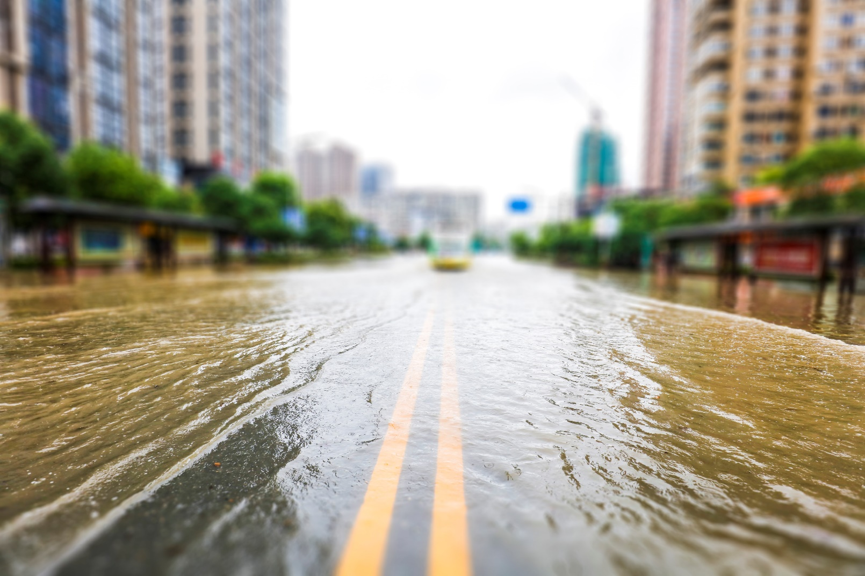
Costs to the Community if We Don’t Manage Stormwater Better
Increased flooding
Infrastructure and property damage
Polluted waterways
Permit non-compliance
Notes:
The cost of not managing stormwater could be much higher than investing in stormwater management.
These problems often mean we need to spend more money to fix the impacts of stormwater in our community.
NOTE: REPLACE THE PHOTO IF YOU HAD ANY FLOODING IN YOUR COMMUNITY AND CUSTOMIZE WITH COSTS SPECIFIC TO YOUR COMMUNITY (e.g., habitat destruction, closed roads and bridges, business closures from flooding)

Slide 5
PERMITTING
Currently Upper Southampton operates the stormwater system under NPDES PERMIT NO. PAI130051
This was approved on MARCH 1, 2021
It expired on FEBRUARY 28, 2026, conditions of the 2021 permit are to be met by then.
The permit was renewed on JANUARY 1, 2026
The main condition of the permit involves removal of sediment, nitrogen and phosphorus among other pollutants from impaired streams
Notes:
A NPDES permit for a storm sewer system is required
The cycle runs for a 5-year period

Slide 6
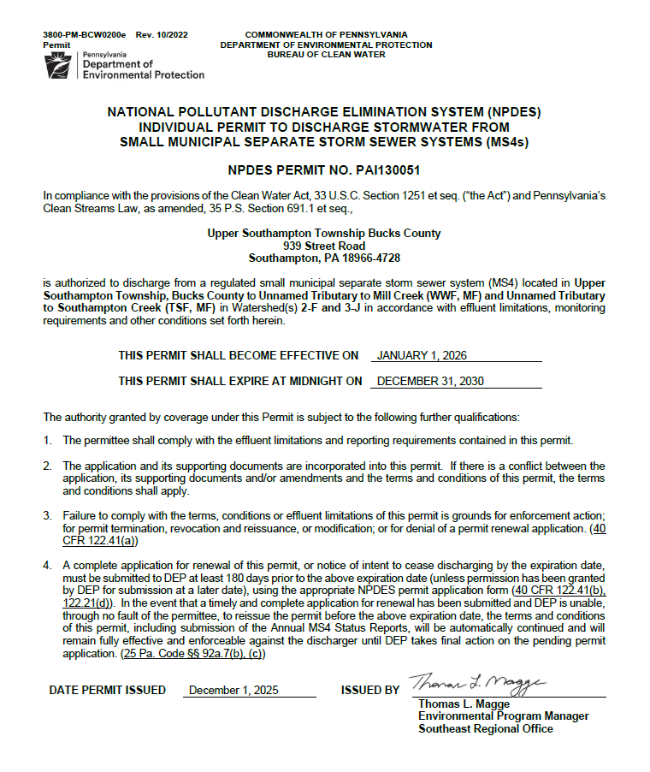


Slide 7
Stormwater Permitting Requirements
There are 6 Minimum Control Measures that are addressed:
MCM #1 – Public Education
MCM #2 – Public Involvement
MCM #3 – Illicit Discharges
MCM #4 – Construction Stormwater
MCM #5 – Post Construction Stormwater
MCM #6 - Municipal Operations
Pollutant Reductions – Sedimentation, Nitrogen and Phosphorus

Slide 8
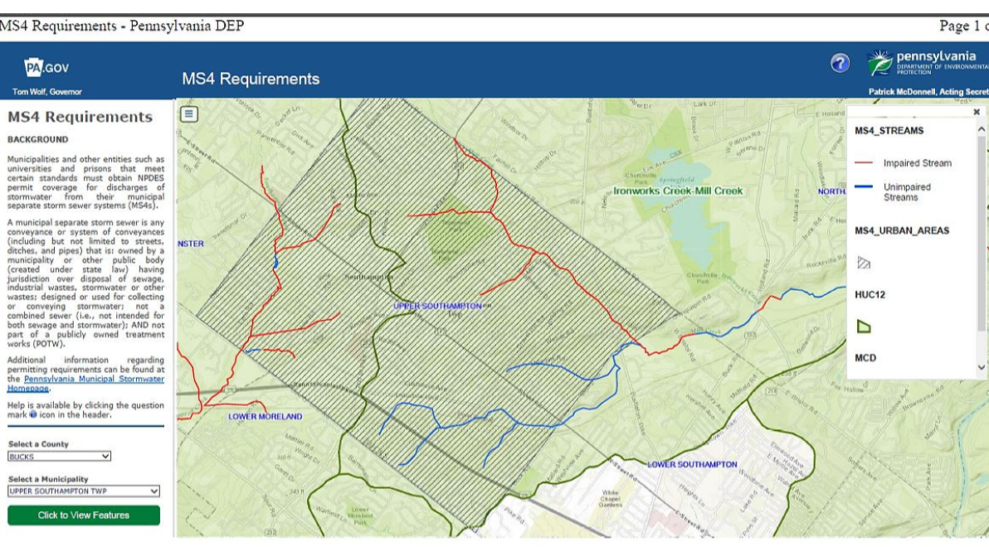
IMPAIRED STREAM IN UPPER SOUTHMAPTON TOWNSHIP

Slide 9
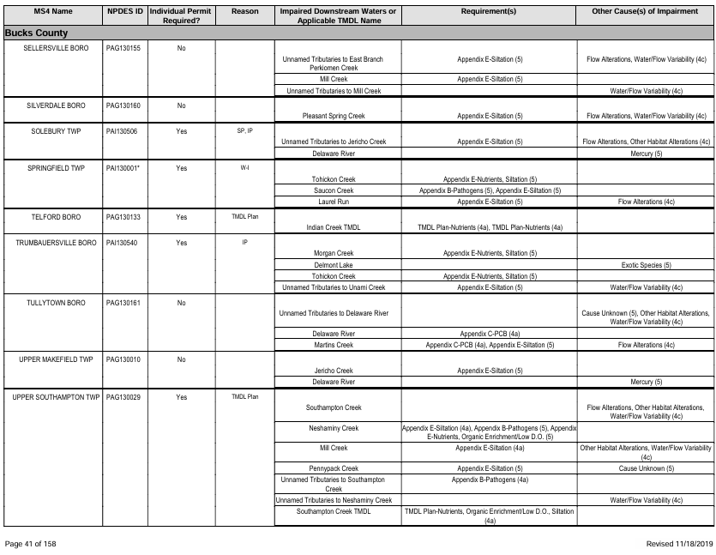
PADEP REQUIREMENTS

Slide 10
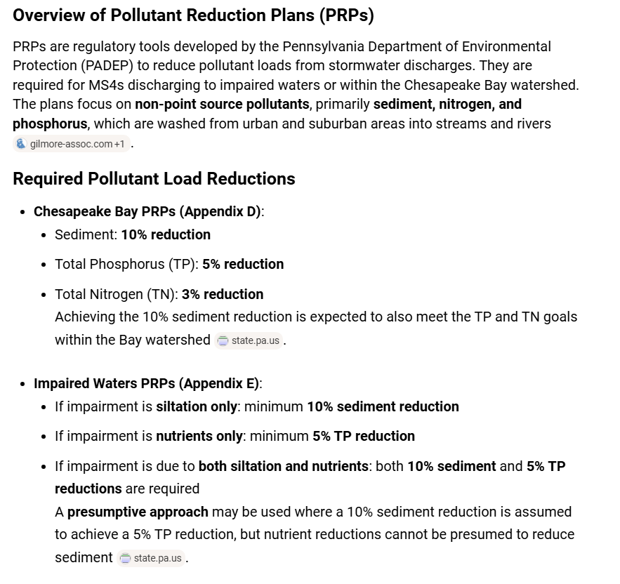
PADEP MS4 REGULATIONS

Slide 11
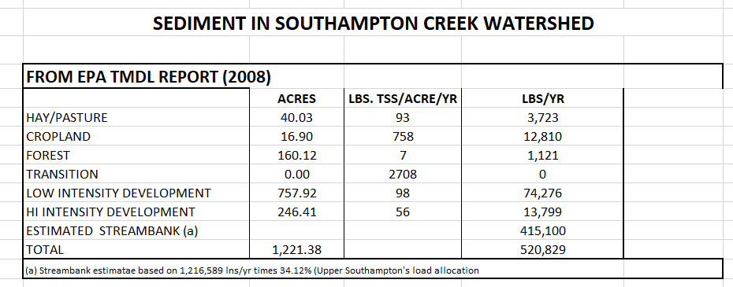
ESTIMATE OF CONTRIBUTION OF STREAMBANK EROSION

Slide 12
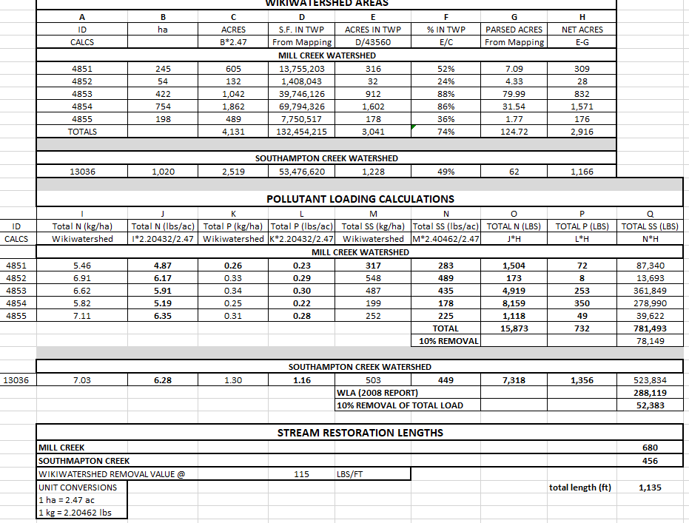

Slide 13
QUESTIONS
??????

